Slide 1
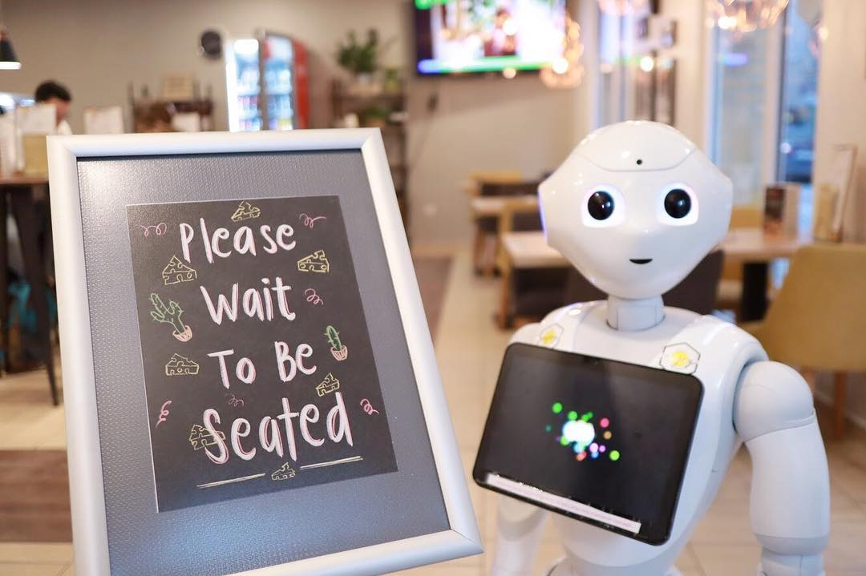
Café Robots In LA – Dream Or Reality?
Ron Sherwi Data Analyst OCT-2020

Slide 2
The goal Choosing the best place to use a robot
Type of restaurant
Chain / individual place
Street
Number of seats in a restaurant

Slide 3
General stats restaurants in los angeles
9651
Places
3997
Chains
484
Streets
44
Seats in a place

Slide 4
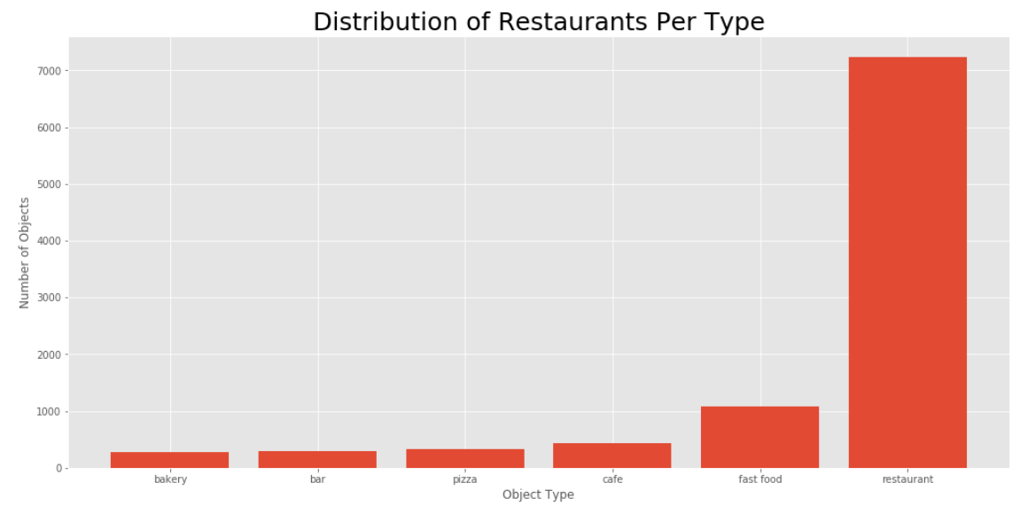

Slide 5

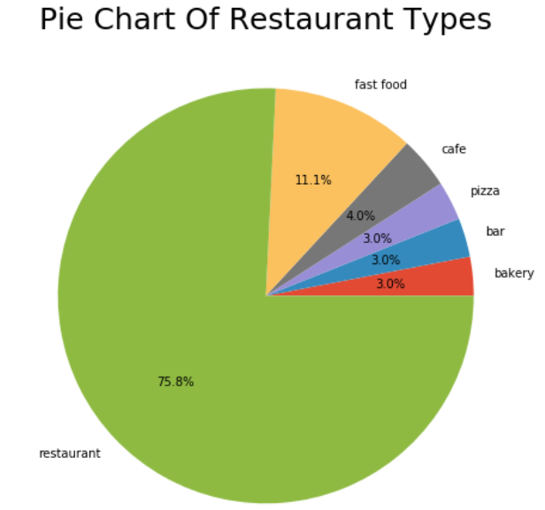
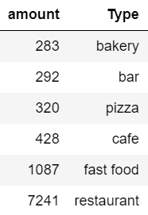

Slide 6
conclusions Types of restaurants
More than 7000 places are regular restaurants
Behind them, more than 1000 are fast food.
Café, bars, pizza and bakeries have 280 – 430 restaurants for each type.

Slide 7

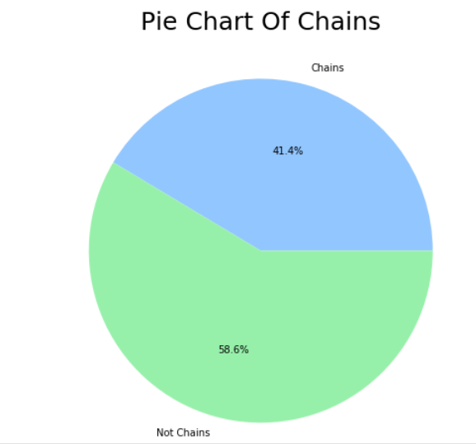
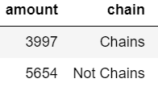

Slide 8
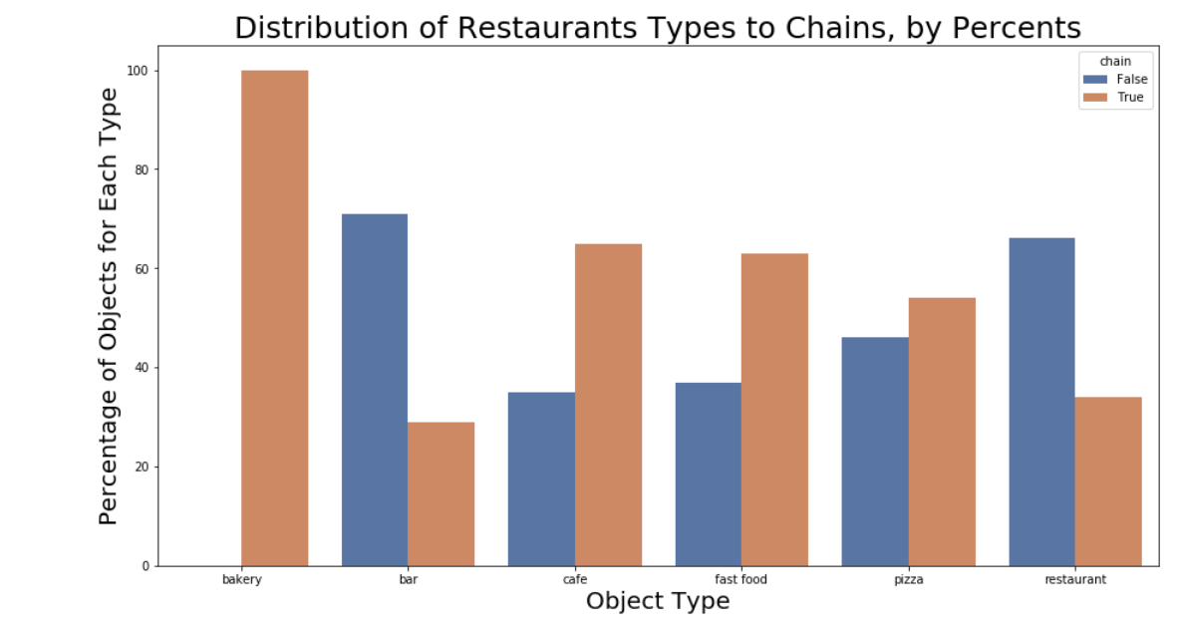


Slide 9
conclusions chains
41% of the restaurants are chains (3997 places).
All the bakeries belong to chains.
Most of the fast food & café (60%) also belong to chains.

Slide 10

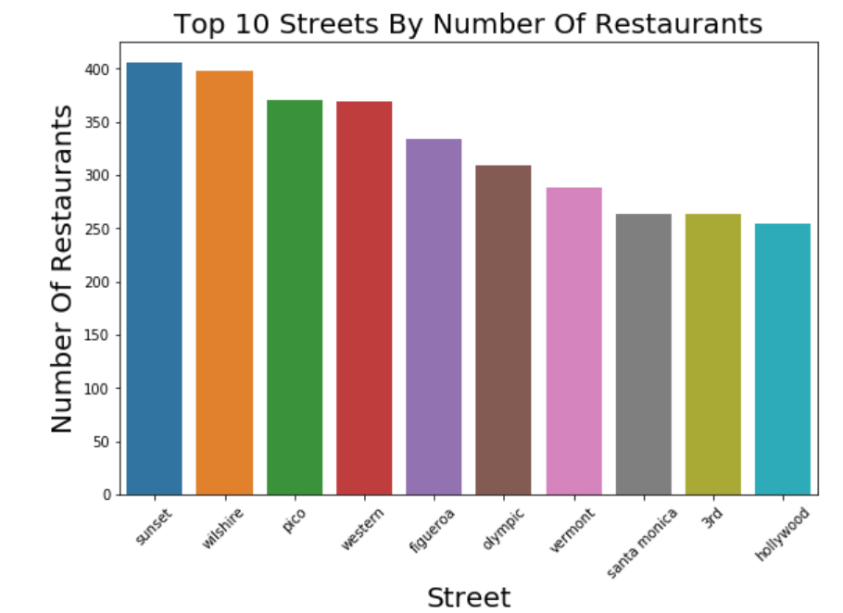

Slide 11

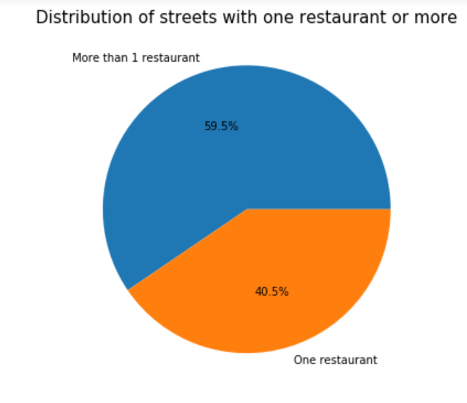

Slide 12

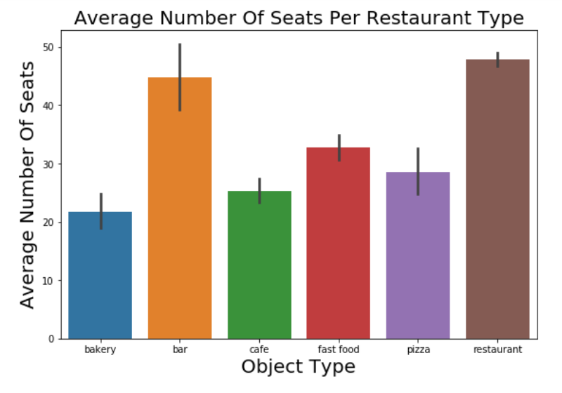
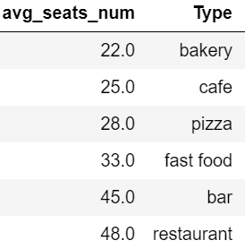

Slide 13
conclusions Streets & Average number of seats
Top 10 streets have 250 – 400 restaurants each one.
59% of the streets have more than one restaurant.
Restaurants and bars have the greatest average number of seats – more than 45 seats each one.
Bakeries (22 seats) and café (25 seats) are behind.

Slide 14
RECCOMENDATIONS
Open a restaurant - more customers more revenues.
In popular street – great marketing.
Start with chain – adapting ourselves to the trend.

